Slide 1
Horizon Airlines – The Brand Ambassadors
Husain Z

Slide 2

The scenario
Scenario: The execs at “Horizon Airlines” want to launch a loyalty program for passengers likely to be satisfied with their flight, turning them into brand ambassadors, while staying within budget.

Slide 3
Problem Statement
The problem: With a limited budget, the company can't afford to give loyalty perks to unsatisfied passengers wrongly labeled as satisfied, leading to wasted expenditure.
We aim to build a predictive model that achieves a precision score of at least 90% to accurately identify genuinely satisfied passengers, ensuring loyalty program resources are allocated efficiently within budget.

Slide 4
Exploratory Data Analytics

Slide 5
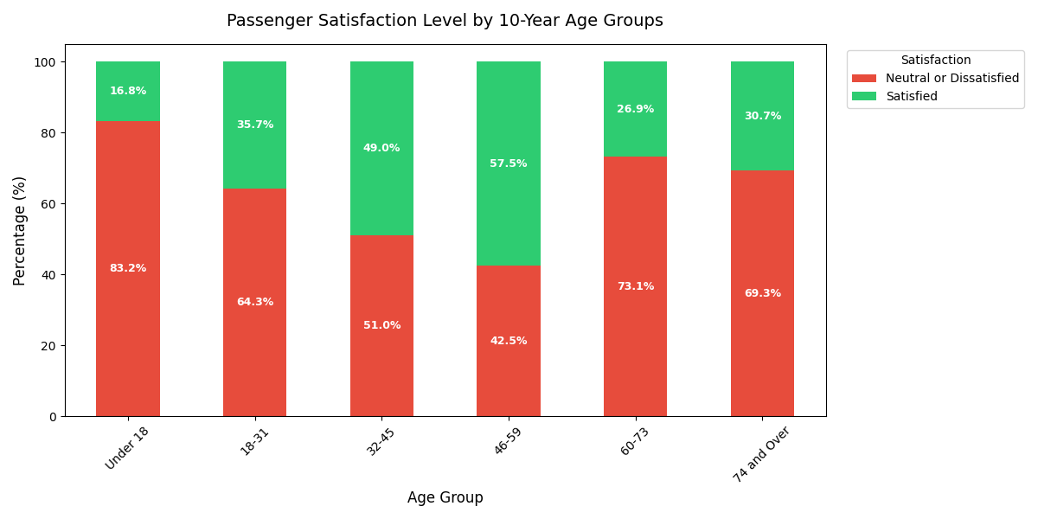
Travelers aged 46–59 exhibit the highest satisfaction rate (57.5%)

Slide 6
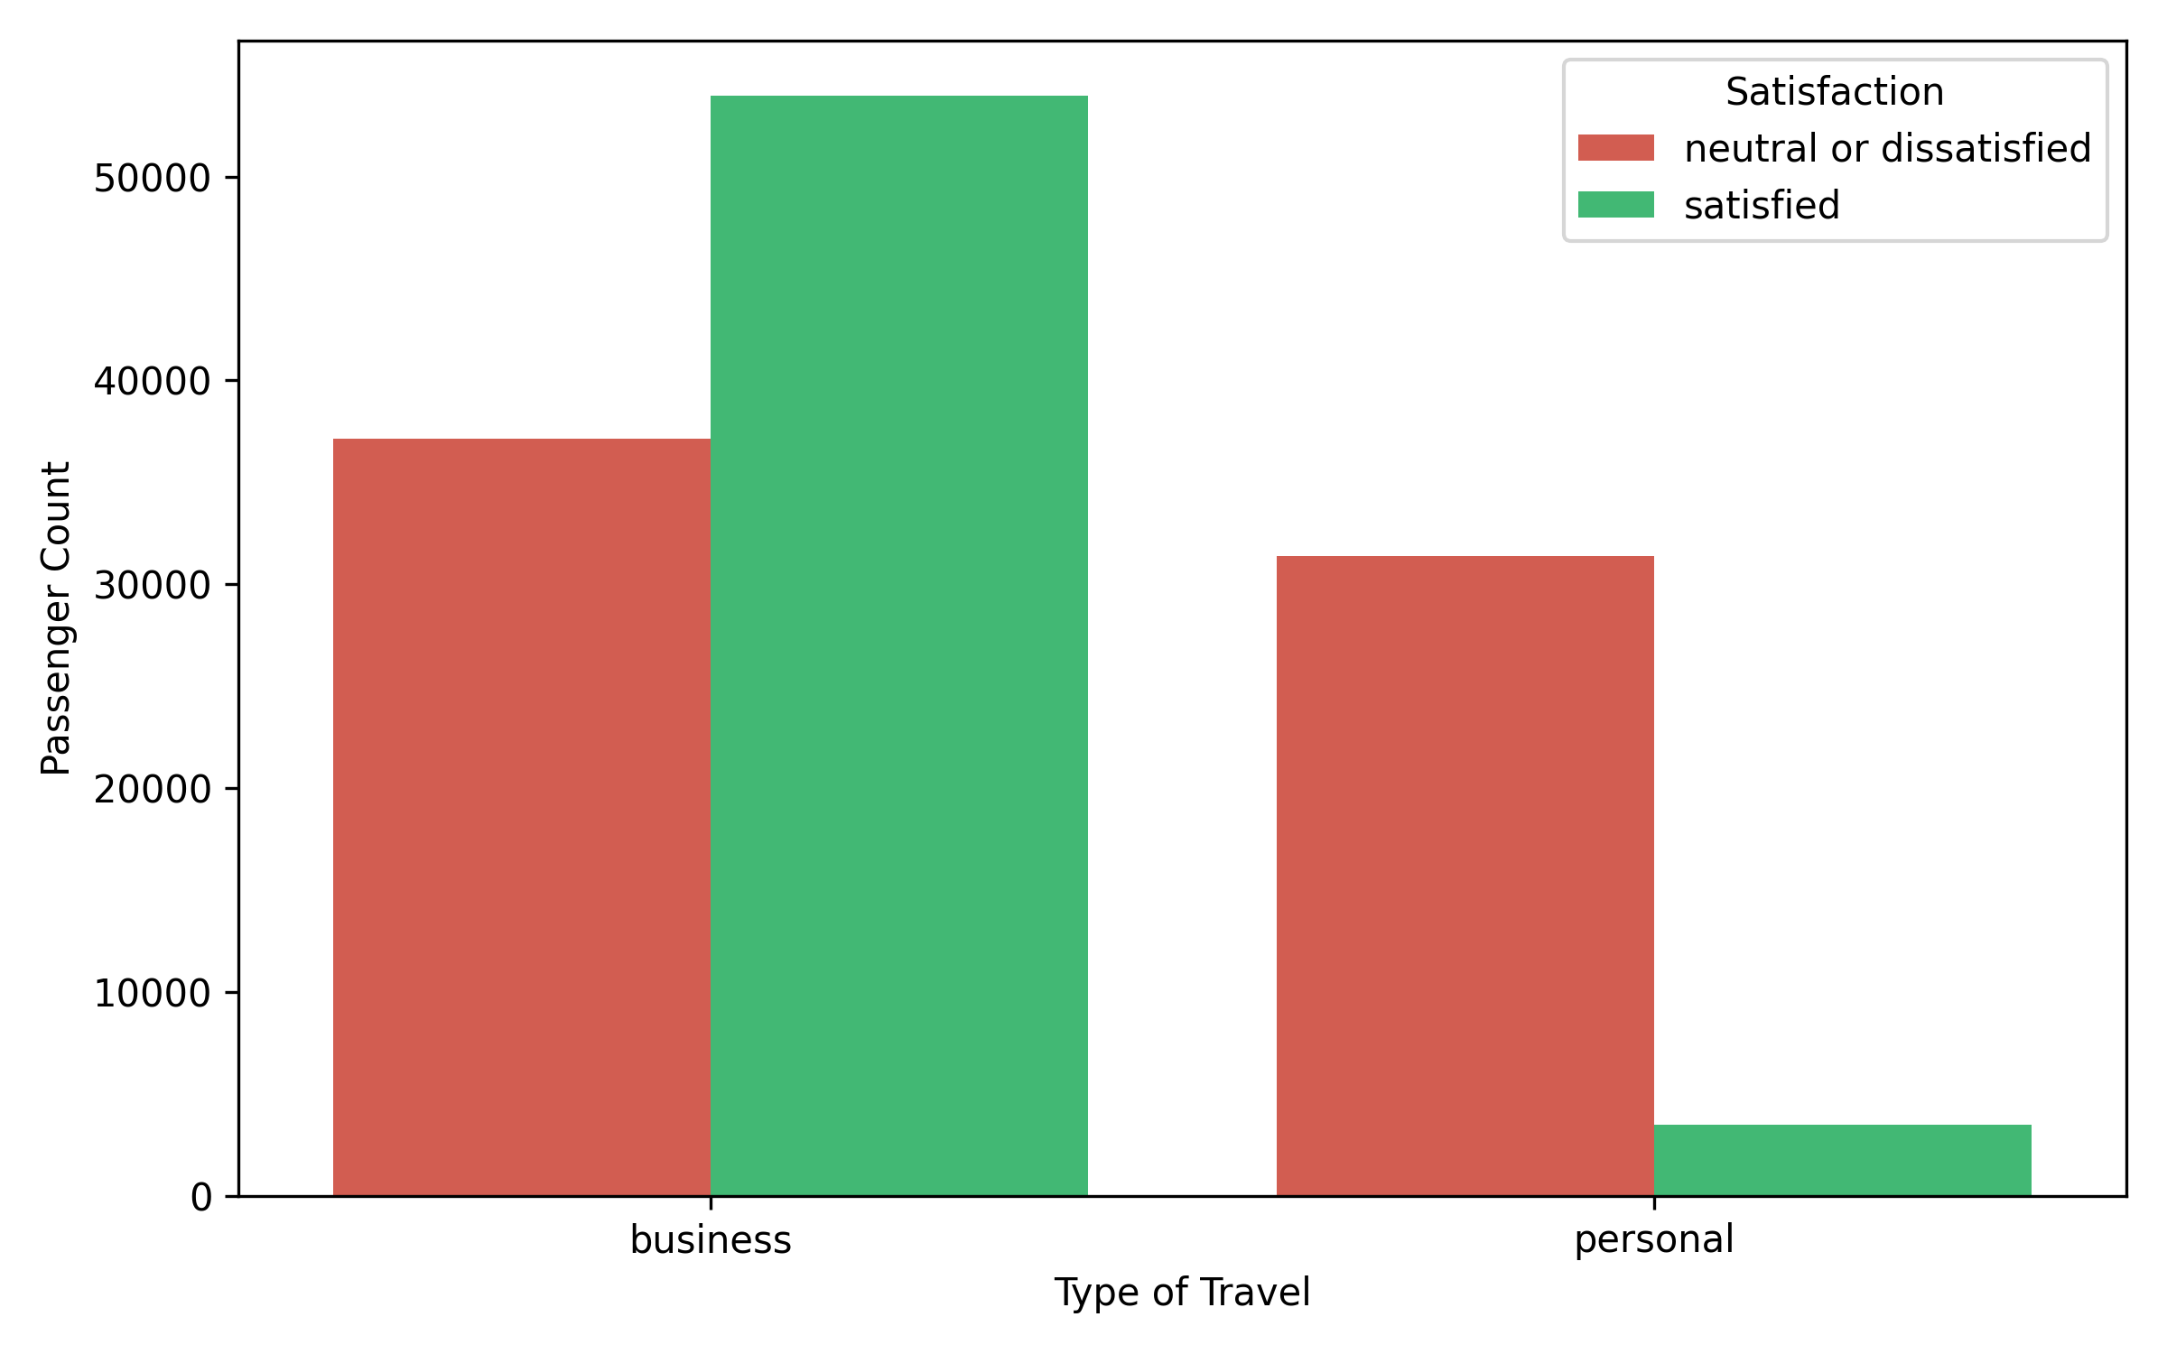
Type of Travel
93%
Business travelers make up over 93% of all satisfied flyers
We can instantly eliminate high-risk, low-precision personal travel segments from our loyalty outreach.
7%

Slide 7
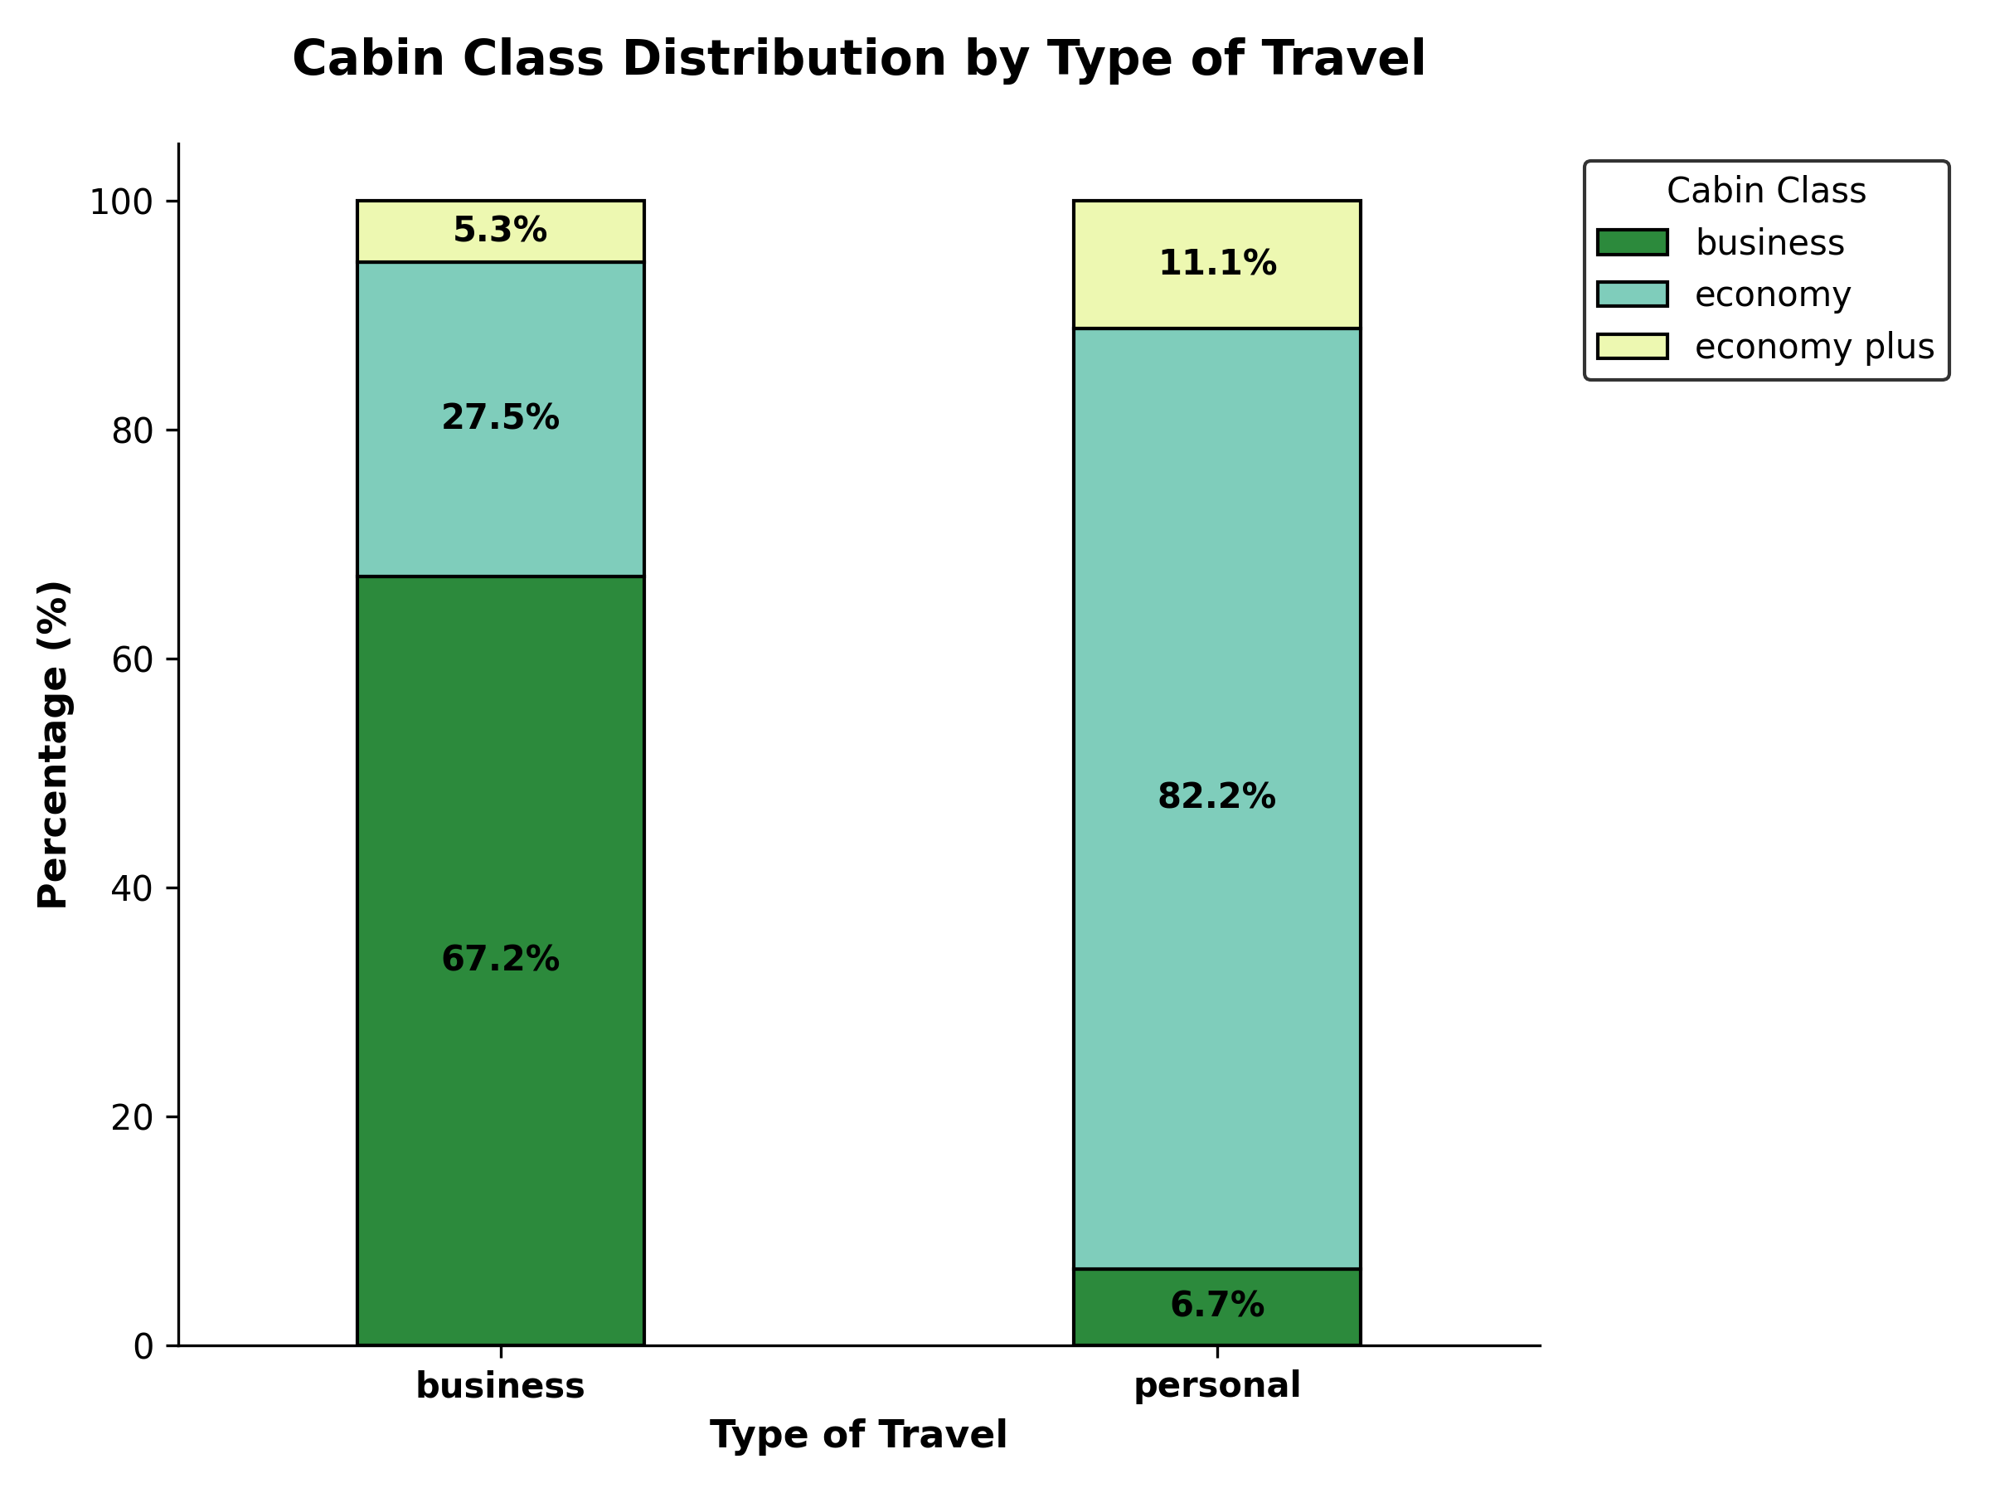
Cabin Class
Premium service is highly linked to business travel (67.2% Business Class).
Targeting premium cabins allows us to cleanly isolate highly-satisfied prospective brand ambassadors.

Slide 8
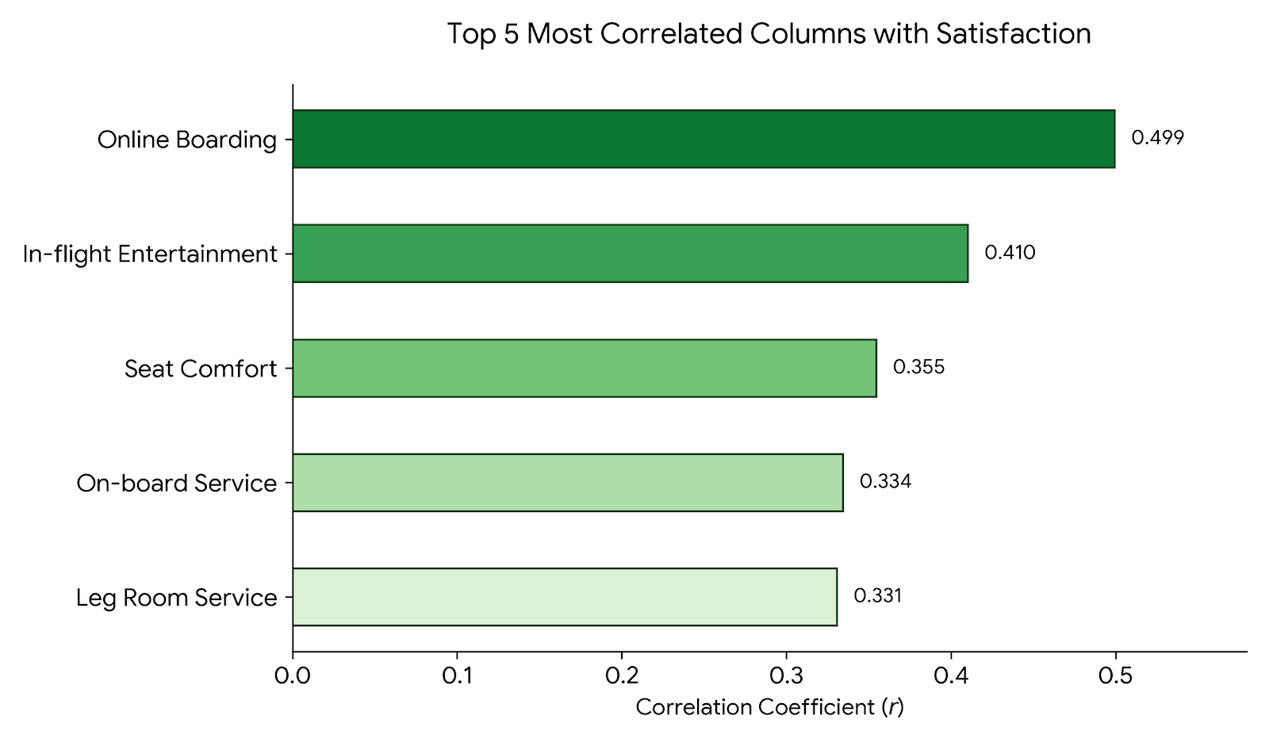
Key Satisfaction Drivers
Online Boarding displays the highest overall correlation.
Concentrating outreach on passengers rating this touchpoint a perfect 5/5 provides a highly precise shortcut to accurate targeting.

Slide 9
Baseline Models

Slide 10

BASELINE KNN Precision
73.85%
BASELINE LOGISTIC REGRESSION PRECISION 87.29%
Neither baseline model meets our strict 90% budget protection limit.
This confirms the necessity of post-modeling threshold tuning.

Slide 11
Optimized Models

Slide 12
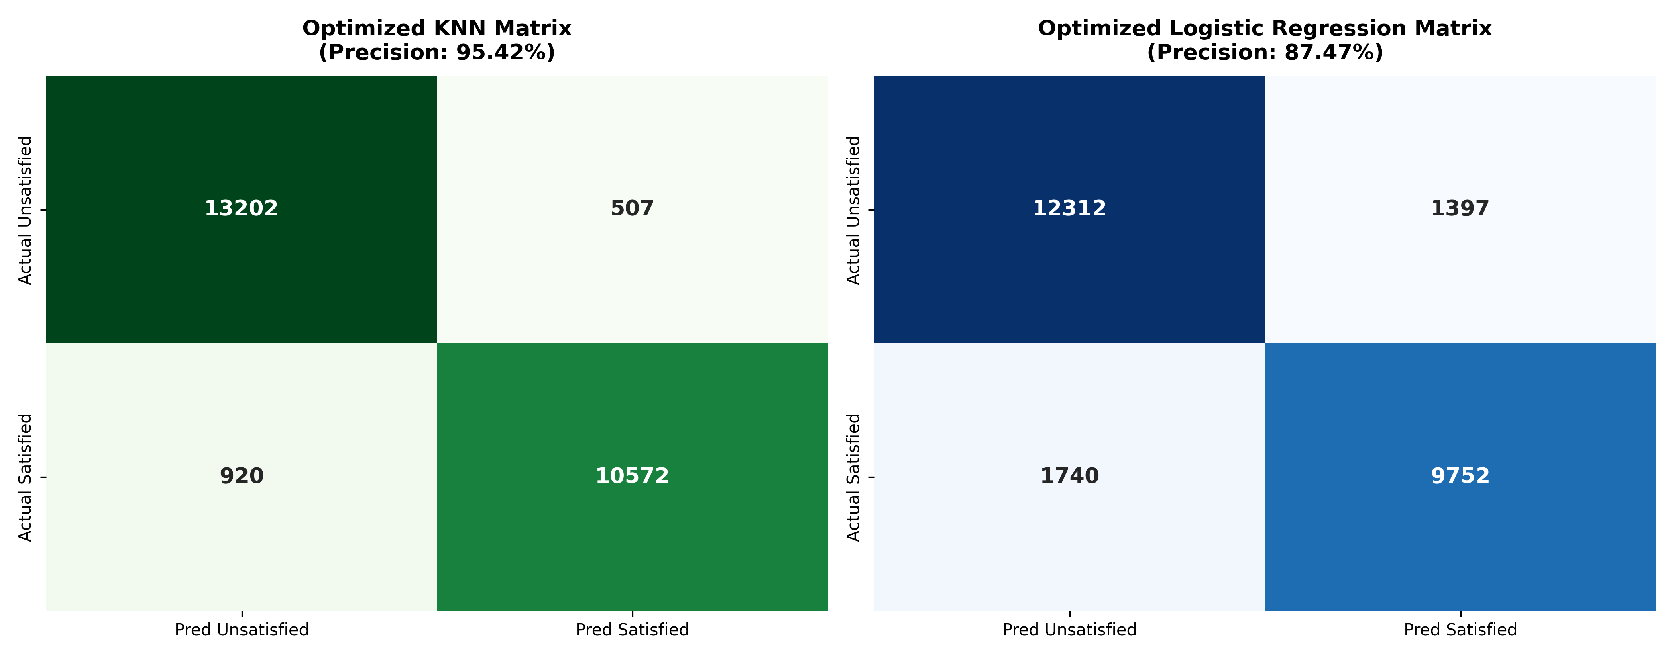
Wasted Expenditure if loyalty program was implemented
13.2K
507
12.3K
1.4K
10.5K
9.7K

Slide 13
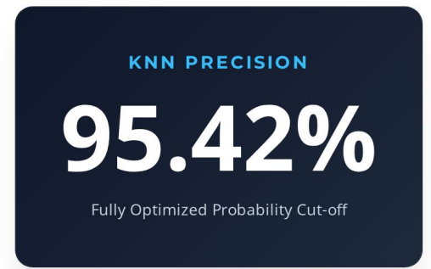
Chosen Model - KNN
The optimized KNN model dramatically
limits False Positives to just 507 cases.
Exceeds the 90% Precision Target.
Identifies 10,572 genuinely satisfied
brand ambassadors.

Slide 14
Conclusion
Our analyses confirm that business class passengers traveling for professional purposes are our prime targets.
They also represent our highly concentrated satisfied audience, giving our models a reliable starting ground.
We should focus on optimizing the Online Boarding experience, which was highlighted in our study as the strongest organic driver of customer happiness.

